Slide 1
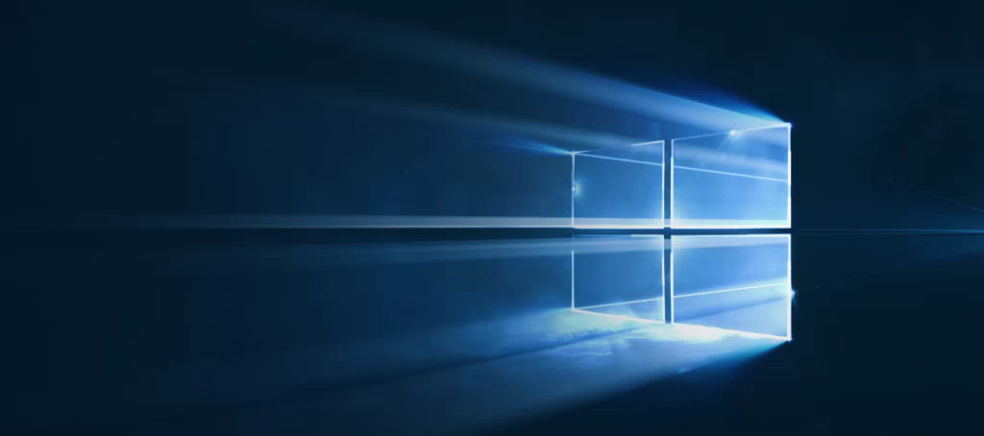
Windows
Camp //Labs
2015

Slide 2




Windows Camp //Labs
#wincamplabs

Slide 3
Живые плитки и уведомления
03
Константин Кичинский
Технологический евангелист, Microsoft

Slide 4
Основы работы с плитками

Slide 5
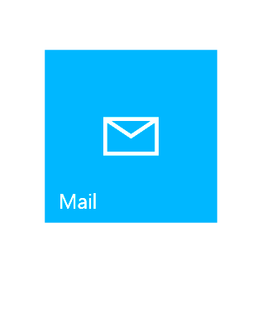
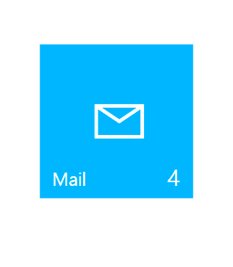
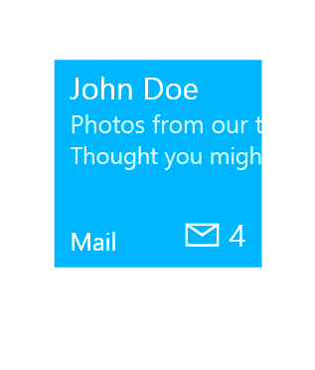
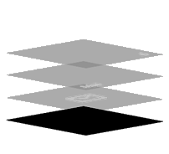
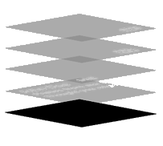
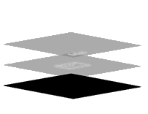
Анатомия плитки
Базовое состояние
«Полуживое» состояние
Живое состояние
Подложка
Подложка
Подложка
Контент
Логотип
Логотип
Иконка приложения
Бейдж
Бейдж
Краткое название
Краткое название
Краткое название
Бейдж
Бейдж
Иконка приложения
Краткое название
Краткое название
Краткое название
Логотип
Логотип
Контент
Подложка
Подложка
Подложка
Notes:
A tile is an app's representation on the Start menu. Every app has a tile. When you create a new Universal Windows Platform (UWP) app project in Microsoft Visual Studio, it includes a default tile that displays your app's name and logo. You can customize the tile so that it changes regularly to communicate new information to the user, such as news headlines, or the subject of the most recent unread message.
You can think of Tiles as being in one of three states.
In its basic state, the tile content is static and it is built up of three layers: the Plate which is the background filled with a configurable color, overlaying that you might have an image probably of the app logo, and optionally over that you can have the app short name.
A semi-live tile adds some dynamic content in the form of a badge count. Your app code can set this badge to a number or to a glyph to indicate to the user that the app has some new content.
A fully live tile incorporates more content to keep the user informed of relevant information. Live Tiles are a channel for your app to deliver content and are a great way for your app to engage with the user encourage them to open the app.

Slide 6
Обновление плиток
По расписанию
Установка шаблона и времени через “ScheduledTileNotification”
Периодично
Запрос по URL и интервалом 30m / 60m / 6h / 12h / 24h
Локальное
Обновление из приложения (активно или в фоне)
Пуш
Пуш-сервис
Обновление бейджей
Notes:
You can update the content of tiles in a number of different ways:
You can use the ScheduledTileNotification class to update the content by applying a tile template at a defined time.
You can define a periodic update in the package manifest, or by calling the StartPeriodicUpdate or StartPeriodicUpdateBatch APIs. You define the URL on a cloud server and the time interval and the system pulls the tile or badge content found at that URL (defined as XML) and applies it to the tile.
You can update a tile or badge directly from code in your foreground app or in a background task
You can use Push Notification services to update tile or badge content from a cloud service.

Slide 7
Шаблоны плиток
Notes:
A tile begins as a default tile, which is defined in your manifest and displayed when your app is first installed. After your app is installed, you can change your tile's content through notifications. When updating tiles, you work with Tile Templates which are objects that encapsulate the XML you need to update a tile.

Slide 8
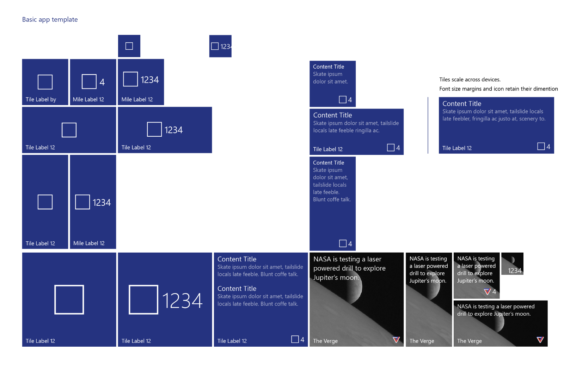
Notes:
There are many different possible sizes for a tile, and many different ways you can configure what is displayed on a tile.

Slide 9
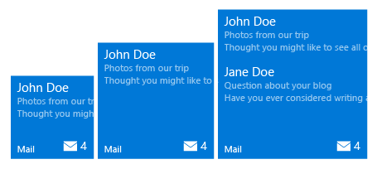
Адаптивные плитки
<tile>
<visual>
<binding template="TileMedium">
<group> <subgroup>
<text hint-style="subtitle">John Doe</text>
<text hint-style="subtle">Photos from our trip</text>
<text hint-style="subtle">Thought you might…</text>
</subgroup>
</group>
<group> <subgroup>
…
</subgroup>
</group>
</binding>
</visual>
</tile>
Min. Med Size
Max Med. Size
Notes:
Adaptive tile templates are a new feature in Windows 10, allowing you to easily specify content on your tile notifications without being limited to the preset templates we provided in earlier versions of Windows in the "tile template catalog". Adaptive tile templates allow you to design your own tile notification content using a simple and flexible markup language that adapts to different densities.
<Click>
In an adaptive tile template, content for each tile size is individually specified in separate <binding> elements within the XML payload. The size you are targeting is specified by setting the template attribute to one of the following values: TileSmall, TileMedium, TileWide or – on desktop only - TileLarge.
A binding element can also specify a language for localisation.
<Click>
Hints are optional attributes that can be added to elements in order to achieve a specific visual behavior. Some hints might be device-specific or notification-specific, hence why they are optional.
<Click>
Adaptive templates are semantic in nature, since they are meant to work across different form factors and different types of notifications. For example, elements like group and subgroup are used to semantically link content together – they do not imply a specific visual behavior on their own. The final appearance is up to the specific device – be it a phone/desktop/Xbox, HoloLens, or smartwatch, and the type of notification – tile or toast.

Slide 10
Уведомления
Notes:
Tiles and Toasts are closely related and use many of the same techniques for defining content and applying updates.

Slide 11
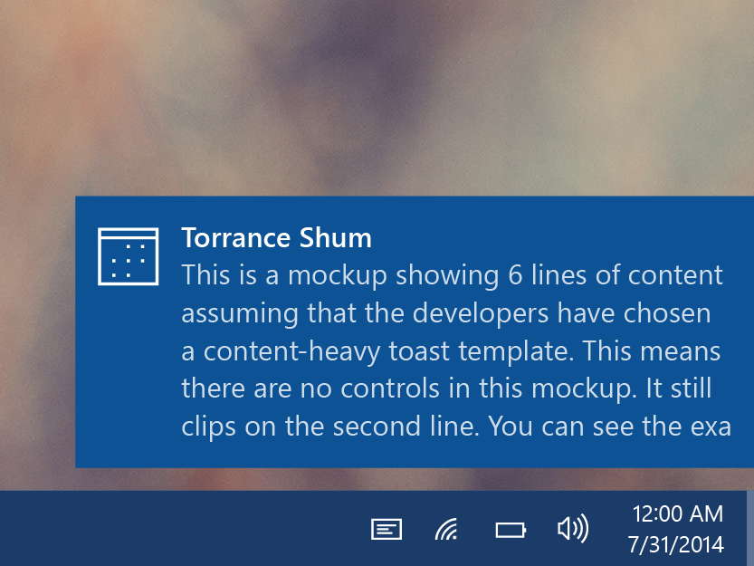
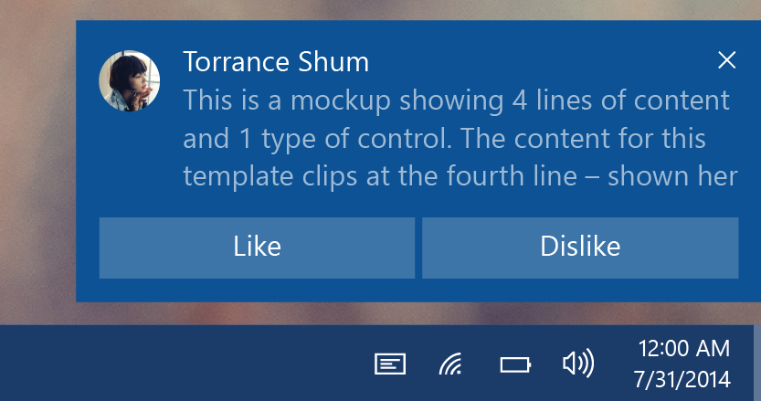
Уведомления
Показ (потребление)
Увидеть новую информацию из приложения.
Действие (принять решение)
Уведомление приглашает начать или завершить выполнение задачи. Уведомление – это открытая дверь в приложение, приглашающая зайти внутрь.
Дополнительные действия позволяют выполнить быстрое действие без смены контекста.
Notes:
Toast notifications are common on all mobile platforms. They provide an interruptive notification of some information for the user. In Windows 10, notifications slide in for a few seconds from the bottom right of a desktop of tablet screen, or appear at the top of a phone screen. They are then listed in Action Center.
In Windows 8.1 and earlier, Toasts simply conveyed information with the goal of the user glancing at it and consuming the information. You can still use toasts in this way in Windows 10.
In Windows 10, toasts get additional capabilities. They can now be interactive and offer buttons and selectable input allowing the user to perform simple tasks directly from the notification, rather than have to open the app to complete the task.

Slide 12
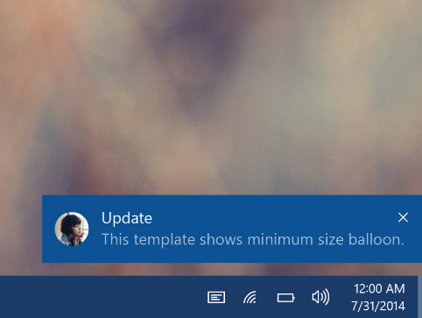
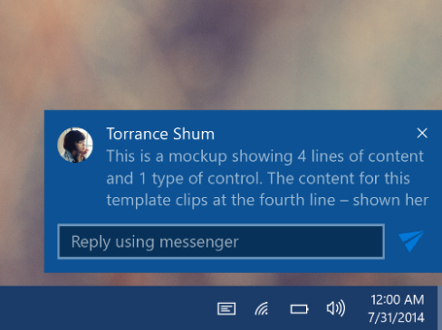
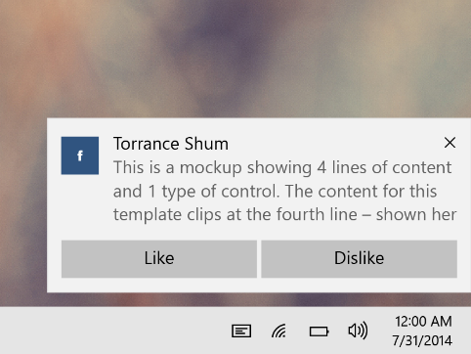
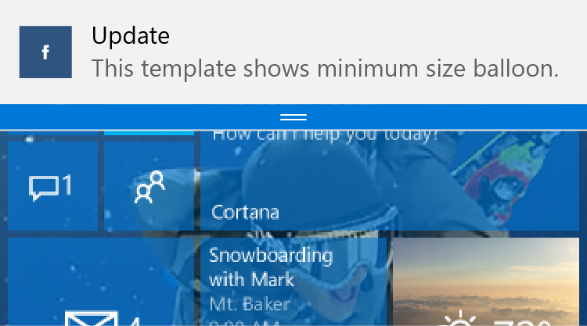
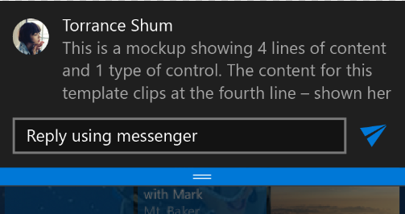
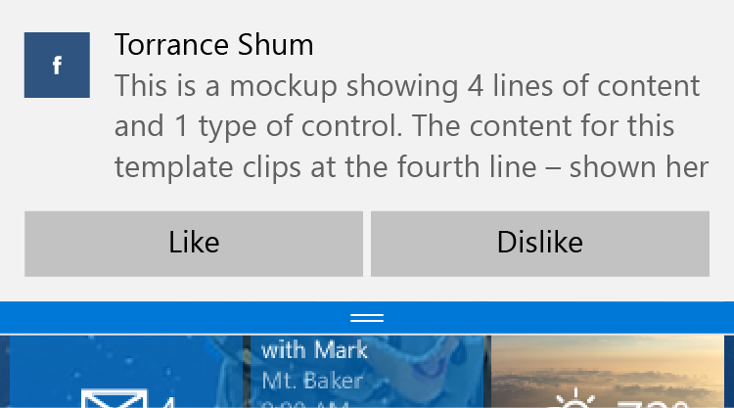
Интерактивные уведомления
Desktop
Mobile
Notes:
The left hand images here – shown for desktop above and below how it appears on Windows 10 Mobile – are non-interactive. They inform the user of some event. The user can tap on the toast and launch the app so that they can take additional actions.
In the middle, we’ve now added an input box and a send button – the user can reply to this message directly from the toast notification, without having to launch the associated app.
In the examples on the right, there are two buttons. The result is the same – the user can be so much more productive because they can use the interactive toast to get things done directly, without having to launch the app!

Slide 13
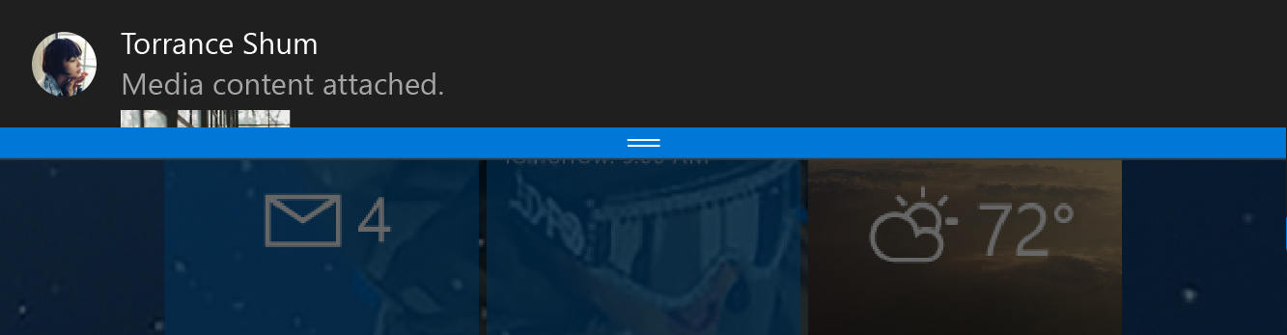
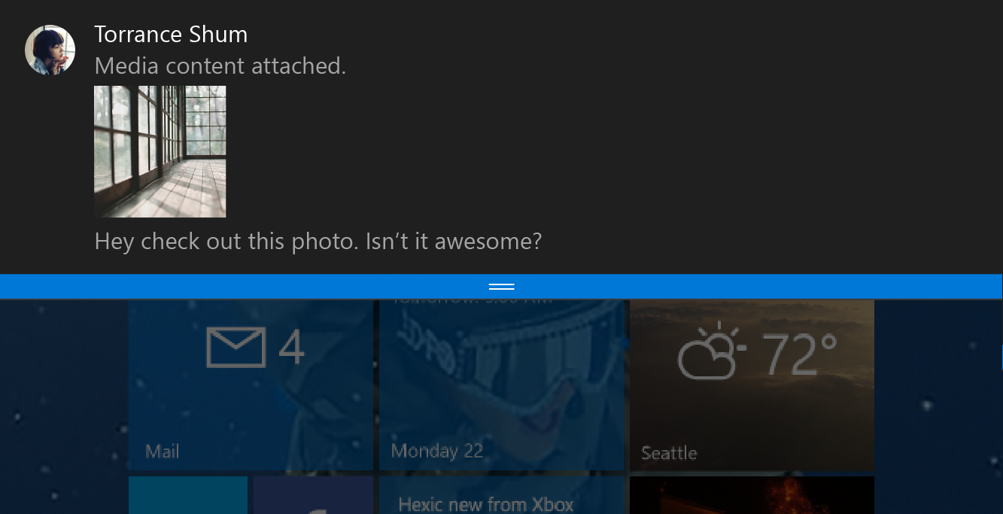
Всплывающие уведомления
<toast>
<visual>
<binding template="ToastGeneric">
<image placement="appLogoOverride"
src="Torrance Shum.png" />
<text>Torrance Shum</text>
<text>Media content attached.</text>
<image placement="inline"
src="attachment.png" />
<text>Hey check out this photo.
Isn’t it awesome?</text>
</binding>
</visual>
</toast>
Notes:
You can define interactive Toasts using a similar adaptive template to that we can use for Tiles.
This example shown here isn’t actually an interactive toast – just an information toast –
<Click>
but this uses adaptive template xml using the ToastGeneric binding, indicating that this is defining a Toast.

Slide 14
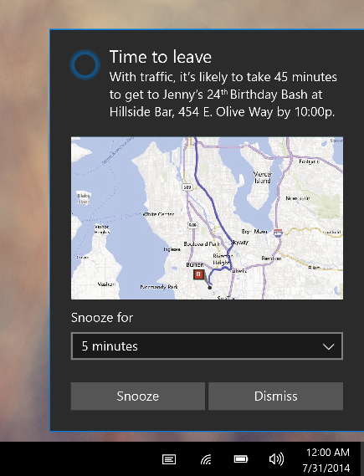
Ввод в уведомлении
<toast>
...
<actions>
<input title="Snooze for" id="snoozeTime"
type="selections" defaultSelection="5">
<selection id="5" content="5 minutes" />
<selection id="10" content="10 minutes" />
<selection id="20" content="20 minutes" />
</input>
...
</actions>
</toast>
Notes:
This example defines two types of interactivity:
<Click>
First there is an <input> element defining a user input
<Click>
This one is of type “selections” so it is a drop-down list
<Click>
Each selectable item is defined, with an ID and the content to display

Slide 15
Действия в уведомлении
<toast>
...
<actions>
...
<action activationType="system" arguments="snooze" hint-inputId="snoozeTime" content=""/>
<action activationType="system" arguments="dismiss" content=""/>
</actions>
</toast>
Notes:
In the same example,
<Click>
the two buttons at the bottom are defined using <action> elements
<Click>
These particular <action> elements are of type “system” with the arguments specified as “snooze” and “dismiss” respectively. The system understands these as buttons that it manages, and these perform the standard snooze and dismiss actions on a reminder.

Slide 16
Лабораторная работа: Плитки и уведомления

